Slide 1

LatentView Proposal – ETL Capabilities
Aug 2018

Slide 2
Agenda
1
About LatentView
2
Our ETL Capabilities
3
Effort Estimation

Slide 3
About LatentView

Slide 4


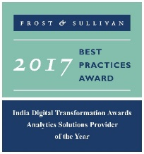




LatentView – A World Class Analytics Company
Awards & Recognition
Founded in
Over
Grown
Work with
Strong Performer - Customer Analytics Services, 2017
600
11
30+
2006
People strong
times in last
six years
Fortune 500
firms
Repeat business at
Member of
2009-2017
Technology council
Rated as Top
10
5%
4/5
>85%
Repeat
business
Analytics companies to work for in India
Re-investment in Research and Development
Top technology companies engage with us

Slide 5
Cutting Edge Solutions in Advanced Analytics
Hindsight – What happened?
Insight – Why did it happen?
Foresight – What should we do?
Data Acquisition
Acquiring the data from both traditional, big data and other digital sources.
Data Processing
Data preparation for analysis and insights, using internal, external, batch, streaming, structured, unstructured data. (On-premise and cloud based techs)
Reporting & Visualization
Creating dashboards and reports for a business-focused audience
Graph Analysis
Better exploration of frequency, strength and direction of relationships
Exploratory Analysis
Experience in gaining deep insights from unstructured and structured data traditional methods
Natural Language Processing
Extract entities, tag PoS, extract relationships, analyze sentiments
Real Time Analytics
Better exploration of frequency, strength and direction of relationships
Deep Learning
Experience in analysing connection data for clustering/ causality
Machine Learning
Deep experience with various machine learning algorithms, including Ensemble Learning, Neural Networks, etc.

Slide 6
Our ETL Capabilities

Slide 7


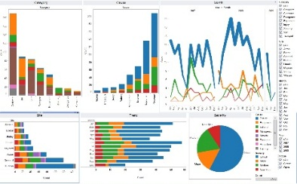





Our ETL Capabilities
Business Needs
To build complex data layers for BI Self Service team on top of the existing Cognos platform
To help BI Self Service team by increasing their Analytics capabilities through Data Modeling and User Training
Extract
Transform
Load
Methodology
ETL Process
The process of extracting the data from Multiple sources
Transform the extracted data to required format
Load the transformed data to a common destination
Data Modeling
Logical Data Modeling : Model with complete entity-relationship structure of the target
Physical Data Modeling : Model with proper table structure, their relationship and data constraints
Tables are to be structured in physical modelling considering the data integrity
Data Sources
Data Validation
Data Cleansing
Data Processing
Data Mart
Data Visualization
Scheduling & Automation
Data Sources : Data from multiple platform which are to be sourced.
Data Cleansing : Improper and duplicate records should be cleaned.
Data Processing (ETL) : Cleaned data from various sourced are extracted and loaded into the target data mart.
Data Mart : All the required data are sourced to target data mart ready to use in a efficient manner.
Reporting/ Visualisation : Reporting, Visualisation and Analysis could be performed easily through the data mart.
Scheduling : All the process could be automated to execute the ETL.
L0 – Staging Tables (Temporary tables used for loading tables in L1 and L2 layers)
L1 – Fact Tables (Tables with detailed dimensional data)
L2 – Reporting Tables (Aggregated fact tables built on top of L1 tables)

Slide 8
Effort Estimation

Slide 9









Effort Estimation & Governance Structure
Resources
1 Onsite Resource
2 Offshore Resources
Time Period
3 Months
Pricing
$XXX USD
Note
Agile methodology is to be adopted for this engagement
Additional resources & time duration will be accounted based on the preferred list of analysis
Client
LATENTVIEW ONSHORE TEAM
LATENTVIEW OFFSHORE TEAM
CLIENT PROGRAM
MANAGER
ENGAGEMENT MANAGER
PROJECT MANAGER
CLIENT TEAM
TEAM LEADS
DATA
ANALYSTS
TABLEAU
EXPERTS

Slide 10
Thank You
amritsagar.mohapatra@latentview.com

